Slide 1

William Stallings Computer Organization and Architecture 10th Edition
Notes:
Lecture slides prepared for “Computer Organization and Architecture”, 10/e, by William Stallings, Chapter 1 “Introduction”.

Slide 2
COURSE ASSESSMENT
Assignments (4) --------------------- 20%
Quizzes(4) ------------------------- 10%
Mid Term ------------------------- 20%
Final --------------------------- 50%
Total ----------------------------- 100%

Slide 3
ATTENDANCE ALERT
Keep track of your attendance throughout the semester
Need to maintain 75% attendance at the end of semester

Slide 4
BOOKS
William Stallings, Computer Organization and. Architecture, 10th Edition, Prentice Hall, 2016
Computer Systems: A Programmer's Perspective, 3/E, Randal E. Bryant and David R.O' Hallaron
Kip R. Irvine, Assembly Language for x86 Processors,7th edition, Prentice Hall, 2014

Slide 5
Chapter 1
Basic Concepts and Computer Evolution
Notes:
In a class of computers called microcomputers, the relationship between architecture
and organization is very close. Changes in technology not only influence
organization but also result in the introduction of more powerful and more complex
architectures. Generally, there is less of a requirement for generation-
To-generation compatibility for these smaller machines. Thus, there is more interplay between
organizational and architectural design decisions. An intriguing example of this is
the reduced instruction set computer (RISC), which we examine in Chapter 15.
This book examines both computer organization and computer architecture.
The emphasis is perhaps more on the side of organization. However, because a
computer organization must be designed to implement a particular architectural
specification, a thorough treatment of organization requires a detailed examination
of architecture as well.

Slide 6
Computer Architecture
Computer Organization
Computer Architecture
Attributes of a system visible to the programmer
Have a direct impact on the logical execution of a program
Architectural attributes include:
Instruction set, number of bits used to represent various data types, I/O mechanisms, techniques for addressing memory
Computer Organization
The operational units and their interconnections that realize the architectural specifications
Organizational attributes include:
Hardware details transparent to the programmer, control signals, interfaces between the computer and peripherals, memory technology used
Notes:
In describing computers, a distinction is often made between computer architecture
and computer organization. Although it is difficult to give precise definitions
for these terms, a consensus exists about the general areas covered by each
(e.g., see [VRAN80], [SIEW82], and [BELL78a]); an interesting alternative view
is presented in [REDD76].
Computer architecture refers to those attributes of a system visible to a
programmer or, put another way, those attributes that have a direct impact on
the logical execution of a program. A term that is often used interchangeably with computer
architecture is instruction set architecture (ISA) . The ISA defines instruction
formats, instruction opcodes, registers, instruction and data memory; the effect of
executed instructions on the registers and memory; and an algorithm for controlling
instruction execution. Computer organization refers to the operational
units and their interconnections that realize the architectural specifications.
Examples of architectural attributes include the instruction set, the number of bits
used to represent various data types (e.g., numbers, characters), I/O mechanisms,
and techniques for addressing memory. Organizational attributes include those
hardware details transparent to the programmer, such as control signals; interfaces
between the computer and peripherals; and the memory technology used.
For example, it is an architectural design issue whether a computer will have
a multiply instruction. It is an organizational issue whether that instruction will
be implemented by a special multiply unit or by a mechanism that makes repeated
use of the add unit of the system. The organizational decision may be based on the
anticipated frequency of use of the multiply instruction, the relative speed of the two
approaches, and the cost and physical size of a special multiply unit.
Historically, and still today, the distinction between architecture and organization
has been an important one. Many computer manufacturers offer a family of
computer models, all with the same architecture but with differences in organization.
Consequently, the different models in the family have different price and performance
characteristics. Furthermore, a particular architecture may span many years and
encompass a number of different computer models, its organization changing with
changing technology.

Slide 7

IBM System
370 Architecture
IBM System/370 architecture
Was introduced in 1970
Included a number of models
Could upgrade to a more expensive, faster model without having to abandon original software
New models are introduced with improved technology, but retain the same architecture so that the customer’s software investment is protected
Architecture has survived to this day as the architecture of IBM’s mainframe product line
Notes:
A prominent example of both these phenomena is the IBM
System/370 architecture. This architecture was first introduced in 1970 and included
a number of models. The customer with modest requirements could buy a cheaper,
slower model and, if demand increased, later upgrade to a more expensive, faster
model without having to abandon software that had already been developed. Over
the years, IBM has introduced many new models with improved technology to replace
older models, offering the customer greater speed, lower cost, or both. These newer
models retained the same architecture so that the customer’s software investment was
protected. Remarkably, the System/370 architecture, with a few enhancements, has
survived to this day as the architecture of IBM’s mainframe product line.

Slide 8
Structure and Function
Hierarchical system
Set of interrelated subsystems
Hierarchical nature of complex systems is essential to both their design and their description
Designer need only deal with a particular level of the system at a time
Concerned with structure and function at each level
Structure
The way in which components relate to each other
Function
The operation of individual components as part of the structure
Notes:
A computer is a complex system; contemporary computers contain millions of
Elementary electronic components. How, then, can one clearly describe them?
The key is to recognize the hierarchical nature of most complex systems, including
the computer [SIMO96]. A hierarchical system is a set of interrelated subsystems,
each of the latter, in turn, hierarchical in structure until we reach some lowest level
of elementary subsystem.
The hierarchical nature of complex systems is essential to both their design
and their description. The designer need only deal with a particular level of the
system at a time. At each level, the system consists of a set of components and
their interrelationships. The behavior at each level depends only on a simplified,
abstracted characterization of the system at the next lower level. At each level, the
designer is concerned with structure and function:
• Structure: The way in which the components are interrelated.
• Function: The operation of each individual component as part of the structure.
In terms of description, we have two choices: starting at the bottom and building
up to a complete description, or beginning with a top view and decomposing the
system into its subparts. Evidence from a number of fields suggests that the top-down
approach is the clearest and most effective [WEIN75].
The approach taken in this book follows from this viewpoint. The computer
system will be described from the top down. We begin with the major components
of a computer, describing their structure and function, and proceed to successively
lower layers of the hierarchy. The remainder of this section provides a very brief
overview of this plan of attack.

Slide 9
Function
There are four basic functions that a computer can perform:
Data processing
Data may take a wide variety of forms and the range of processing requirements is broad
Data storage
Short-term
Long-term
Data movement
Input-output (I/O) - when data are received from or delivered to a device (peripheral) that is directly connected to the computer
Data communications – when data are moved over longer distances, to or from a remote device
Control
A control unit manages the computer’s resources and orchestrates the performance of its functional parts in response to instructions
Notes:
Both the structure and functioning of a computer are, in essence, simple. Figure 1.1
depicts the basic functions that a computer can perform. In general terms, there are
only four:
Data Processing. The data may take a wide
variety of forms, and the range of processing requirements is broad. However, we
shall see that there are only a few fundamental methods or types of data processing.
Data Storage. Even if the computer is processing
data on the fly (i.e., data come in and get processed, and the results go out
immediately), the computer must temporarily store at least those pieces of data
that are being worked on at any given moment. Thus, there is at least a short-term
data storage function. Equally important, the computer performs a long-term data
storage function. Files of data are stored on the computer for subsequent retrieval
and update.
Data Movement. The computer’s operating environment consists of devices that serve as
either sources or destinations of data. When data are received from or delivered to
a device that is directly connected to the computer, the process is known as input–
output (I/O), and the device is referred to as a peripheral. When data are moved
over longer distances, to or from a remote device, the process is known as data
communications.
Control. Within the computer, a control unit manages the computer’s resources and orchestrates the
performance of its functional parts in response to those instructions.

Slide 10
Structure
Notes:
We now look in a general way at the internal structure of a computer. We begin with
a traditional computer with a single processor that employs a microprogrammed
control unit, then examine a typical multicore structure.
Figure 1.1 provides a hierarchical view
of the internal structure of a traditional single-processor computer.

Slide 11
CPU – controls the operation of the computer and performs its data processing functions
Main Memory – stores data
I/O – moves data between the computer and its external environment
System Interconnection – some mechanism that provides for communication among CPU, main memory, and I/O
There are four main structural components
of the computer:
Notes:
There are four main structural components:
• Central processing unit (CPU): Controls the operation of the computer and
performs its data processing functions; often simply referred to as processor.
• Main memory: Stores data.
• I/O: Moves data between the computer and its external environment.
• System interconnection: Some mechanism that provides for communication
among CPU, main memory, and I/O. A common example of system interconnection
is by means of a system bus, consisting of a number of conducting
wires to which all the other components attach.

Slide 12
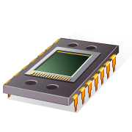
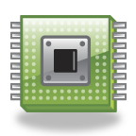
CPU
Control Unit
Controls the operation of the CPU and hence the computer
Arithmetic and Logic Unit (ALU)
Performs the computer’s data processing function
Registers
Provide storage internal to the CPU
CPU Interconnection
Some mechanism that provides for communication among the control unit, ALU, and registers
Major structural components:
Notes:
There may be one or more of each of the aforementioned components.
Traditionally, there has been just a single processor. In recent years, there has been
increasing use of multiple processors in a single computer. Some design issues relating
to multiple processors crop up and are discussed as the text proceeds; Part Five
focuses on such computers.
Each of these components will be examined in some detail in Part Two.
However, for our purposes, the most interesting and in some ways the most complex
component is the CPU. Its major structural components are as follows:
• Control unit: Controls the operation of the CPU and hence the computer.
• Arithmetic and logic unit (ALU): Performs the computer’s data processing
functions.
• Registers: Provides storage internal to the CPU.
• CPU interconnection: Some mechanism that provides for communication
among the control unit, ALU, and registers.
Part Three covers these components, where we will see that complexity is added by
the use of parallel and pipelined organizational techniques. Finally, there are several
approaches to the implementation of the control unit; one common approach is
a microprogrammed implementation. In essence, a microprogrammed control unit
operates by executing microinstructions that define the functionality of the control
unit. With this approach, the structure of the control unit can be depicted, as in
Figure 1.1. This structure is examined in Part Four.

Slide 13
Multicore Computer Structure
Central processing unit (CPU)
Portion of the computer that fetches and executes instructions
Consists of an ALU, a control unit, and registers
Referred to as a processor in a system with a single processing unit
Core
An individual processing unit on a processor chip
May be equivalent in functionality to a CPU on a single-CPU system
Specialized processing units are also referred to as cores
Processor
A physical piece of silicon containing one or more cores
Is the computer component that interprets and executes instructions
Referred to as a multicore processor if it contains multiple cores
Notes:
As was mentioned, contemporary
computers generally have multiple processors. When these processors all reside
on a single chip, the term multicore computer is used, and each processing unit
(consisting of a control unit, ALU, registers, and perhaps cache) is called a core . To
clarify the terminology, this text will use the following definitions.
■ Central processing unit (CPU) : That portion of a computer that fetches and
executes instructions. It consists of an ALU, a control unit, and registers. In a
system with a single processing unit, it is often simply referred to as a processor .
■ Core : An individual processing unit on a processor chip. A core may be
equivalent in functionality to a CPU on a single-CPU system. Other specialized processing units,
such as one optimized for vector and matrix operations, are also referred to as cores.
■ Processor: A physical piece of silicon containing one or more cores. The
processor is the computer component that interprets and executes instructions.
If a processor contains multiple cores, it is referred to as a multicore
processor .
After about a decade of discussion, there is broad industry consensus on this
usage.

Slide 14
Cache Memory
Multiple layers of memory between the processor and main memory
Is smaller and faster than main memory
Used to speed up memory access by placing in the cache data from main memory that is likely to be used in the near future
A greater performance improvement may be obtained by using multiple levels of cache, with level 1 (L1) closest to the core and additional levels (L2, L3, etc.) progressively farther from the core
Notes:
Another prominent feature of contemporary computers is the use of multiple
layers of memory, called cache memory , between the processor and main memory.
Chapter 4 is devoted to the topic of cache memory. For our purposes in this section,
we simply note that a cache memory is smaller and faster than main memory and is
used to speed up memory access by placing in the cache, data from main memory
that is likely to be used in the near future. A greater performance improvement may
be obtained by using multiple levels of cache, with level 1 (L1) closest to the core
and additional levels (L2, L3, and so on) progressively farther from the core. In this
scheme, level n is smaller and faster than level n + 1.

Slide 15
Notes:
Figure 1.2 is a simplified view of the principal components of a typical multicore
computer. Most computers, including embedded computers in smartphones
and tablets, plus personal computers, laptops, and workstations, are housed on a
motherboard. Before describing this arrangement, we need to define some terms.
A printed circuit board is a rigid, flat board that holds and interconnects chips and
other electronic components. The board is made of layers, typically two to ten,
that interconnect components via copper pathways that are etched into the board.
The main printed circuit board (PCB) in a computer is called a system board or
motherboard , while smaller ones that plug into the slots in the main board are
called expansion boards.
The most prominent elements on the motherboard are the chips. A chip is
a single piece of semiconducting material, typically silicon, upon which electronic
circuits and logic gates are fabricated. The resulting product is referred to as an
integrated circuit .
The motherboard contains a slot or socket for the processor chip, which typically
contains multiple individual cores, in what is known as a multicore processor .
There are also slots for memory chips, I/O controller chips, and other key computer
components. For desktop computers, expansion slots enable the inclusion of more
components on expansion boards. Thus, a modern motherboard connects only a
few individual chip components, with each chip containing from a few thousand up
to hundreds of millions of transistors.
Figure 1.2 shows a processor chip that contains eight cores and an L3 cache.
Not shown is the logic required to control operations between the cores and the
cache and between the cores and the external circuitry on the motherboard. The
figure indicates that the L3 cache occupies two distinct portions of the chip surface.
However, typically, all cores have access to the entire L3 cache via the aforementioned
control circuits. The processor chip shown in Figure 1.2 does not represent
any specific product, but provides a general idea of how such chips are laid out.
Next, we zoom in on the structure of a single core, which occupies a portion of
the processor chip. In general terms, the functional elements of a core are:
■ Instruction logic: This includes the tasks involved in fetching instructions and
decoding each instruction to determine the instruction operation and the
memory locations of any operands.
■ Arithmetic and logic unit (ALU): Performs the operation specified by an
instruction.
■ Load/store logic: Manages the transfer of data to and from main memory via
cache.
The core also contains an L1 cache, split between an instruction cache
(I-cache) that is used for the transfer of instructions to and from main memory, and
an L1 data cache, for the transfer of operands and results. Typically, today’s processor
chips also include an L2 cache as part of the core. In many cases, this cache
is also split between instruction and data caches, although a combined, single L2
cache is also used.
Keep in mind that this representation of the layout of the core is only intended
to give a general idea of internal core structure. In a given product, the functional
elements may not be laid out as the three distinct elements shown in Figure 1.2,
especially if some or all of these functions are implemented as part of a microprogrammed
control unit.

Slide 16
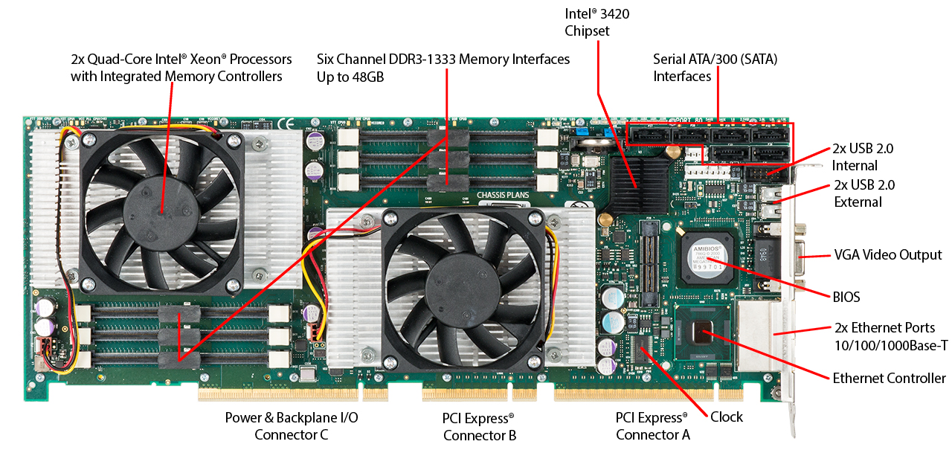
Figure 1.3
Motherboard with Two Intel Quad-Core Xeon Processors
Notes:
It will be instructive to look at some real-
world examples that illustrate the hierarchical structure of computers.
Figure 1.3 is a photograph of the
motherboard for a computer built around two Intel Quad-Core
Xeon processor chips. Many of the elements labeled on the photograph are discussed subsequently
in this book. Here, we mention the most important, in addition to the processor
sockets:
■ PCI-Express slots for a high-end
display adapter and for additional peripherals
(Section 3.6 describes PCIe).
■ Ethernet controller and Ethernet ports for network connections.
■ USB sockets for peripheral devices.
■ Serial ATA (SATA) sockets for connection to disk memory (Section 7.7
discusses Ethernet, USB, and SATA).
■ Interfaces for DDR (double data rate) main memory chips (Section 5.3
discusses DDR).
■ Intel 3420 chipset is an I/O controller for direct memory access operations
between peripheral devices and main memory (Section 7.5 discusses DDR).

Slide 17
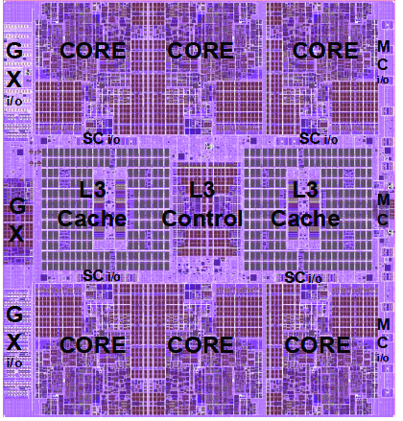
Figure 1.4
zEnterprise EC12 Processor Unit (PU)
Chip Diagram
Notes:
Following our top-down
strategy, as illustrated in Figures 1.1 and 1.2, we can
now zoom in and look at the internal structure of a processor chip. For variety, we
look at an IBM chip instead of the Intel processor chip. Figure 1.4 is a photograph
of the processor chip for the IBM zEnterprise EC12 mainframe computer. This chip
has 2.75 billion transistors. The superimposed labels indicate how the silicon real
estate of the chip is allocated. We see that this chip has six cores, or processors.
In addition, there are two large areas labeled L3 cache, which are shared by all six
processors. The L3 control logic controls traffic between the L3 cache and the cores
and between the L3 cache and the external environment. Additionally, there is storage
control (SC) logic between the cores and the L3 cache. The memory controller
(MC) function controls access to memory external to the chip. The GX I/O bus
controls the interface to the channel adapters accessing the I/O.

Slide 18
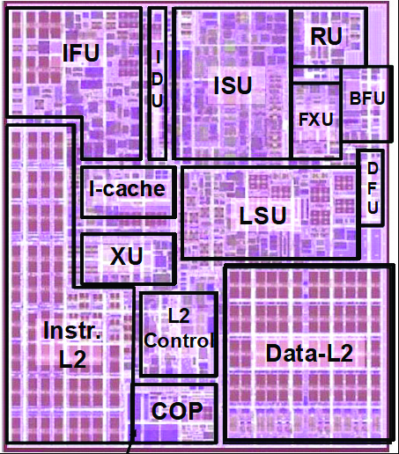
Figure 1.5
zEnterprise
EC12
Core Layout
Notes:
Going down one level deeper, we examine the internal structure of a single
core, as shown in the photograph of Figure 1.5. Keep in mind that this is a portion
of the silicon surface area making up a single-
processor chip. The main sub-areas
within this core area are the following:
■ ISU (instruction sequence unit): Determines the sequence in which instructions
are executed in what is referred to as a superscalar architecture (Chapter 16).
■ IFU (instruction fetch unit): Logic for fetching instructions.
■ IDU (instruction decode unit): The IDU is fed from the IFU buffers, and is
responsible for the parsing and decoding of all z/Architecture operation codes.
■ LSU (load-store unit): The LSU contains the 96-kB L1 data cache1, and manages
data traffic between the L2 data cache and the functional execution
units. It is responsible for handling all types of operand accesses of all lengths,
modes, and formats as defined in the z/Architecture.
■ XU (translation unit): This unit translates logical addresses from instructions
into physical addresses in main memory. The XU also contains a translation
lookaside buffer (TLB) used to speed up memory access. TLBs are discussed
in Chapter 8.
■ FXU (fixed-point unit): The FXU executes fixed-
point arithmetic operations.
■ BFU (binary floating-
point unit): The BFU handles all binary and hexadecimal
Floating-point operations, as well as fixed-point
multiplication operations.
■ DFU (decimal floating-point unit): The DFU handles both fixed-point
and floating-point
operations on numbers that are stored as decimal digits.
■ RU (recovery unit): The RU keeps a copy of the complete state of the system
that includes all registers, collects hardware fault signals, and manages the
hardware recovery actions.
■ COP (dedicated co-
processor): The COP is responsible for data compression
and encryption functions for each core.
■ I-cache: This is a 64-kB L1 instruction cache, allowing the IFU to prefetch
instructions before they are needed.
■ L2 control: This is the control logic that manages the traffic through the two
L2 caches.
■ Data- L2: A 1-MB L2 data cache for all memory traffic other than instructions.
■ Instr-
L2: A 1-MB L2 instruction cache.

Slide 19
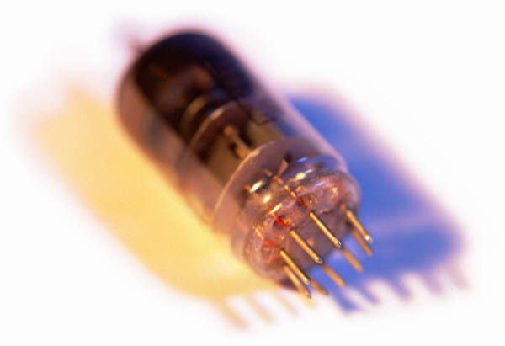
History of Computers
First Generation: Vacuum Tubes
Vacuum tubes were used for digital logic elements and memory
IAS computer
Fundamental design approach was the stored program concept
Attributed to the mathematician John von Neumann
First publication of the idea was in 1945 for the EDVAC
Design began at the Princeton Institute for Advanced Studies
Completed in 1952
Prototype of all subsequent general-purpose computers
Notes:
The first generation of computers used vacuum tubes for digital logic elements and
memory. A number of research and then commercial computers were built using
vacuum tubes. For our purposes, it will be instructive to examine perhaps the most
famous first-generation computer, known as the IAS computer.
A fundamental design approach first implemented in the IAS computer is
known as the stored-program concept . This idea is usually attributed to the mathematician
John von Neumann. Alan Turing developed the idea at about the same time.
The first publication of the idea was in a 1945 proposal by von Neumann for a new
computer, the EDVAC (Electronic Discrete Variable Computer).3
In 1946, von Neumann and his colleagues began the design of a new stored-
program computer, referred to as the IAS computer, at the Princeton Institute for
Advanced Studies. The IAS computer, although not completed until 1952, is the
prototype of all subsequent general-purpose computers.

Slide 20
Notes:
Figure 1.6 shows the general structure of the IAS computer (compare with Figure 1.1).
It consists of
• A main memory, which stores both data and instructions
• An arithmetic and logic unit (ALU) capable of operating on binary data
• A control unit, which interprets the instructions in memory and causes them
to be executed
• Input/output (I/O) equipment operated by the control unit
This structure was outlined in von Neumann’s earlier proposal, which is worth
quoting in part at this point [VONN45]:
2.2 First: Since the device is primarily a computer, it will
have to perform the elementary operations of arithmetic most frequently.
These are addition, subtraction, multiplication, and division.
It is therefore reasonable that it should contain specialized
organs for just these operations.
It must be observed, however, that while this principle as such
is probably sound, the specific way in which it is realized requires
close scrutiny. At any rate a central arithmetical part of the device will
probably have to exist, and this constitutes the first specific part: CA .
2.3 Second: The logical control of the device, that is, the
proper sequencing of its operations, can be most efficiently carried
out by a central control organ. If the device is to be elastic ,
that is, as nearly as possible all purpose , then a distinction must
be made between the specific instructions given for and defining
a particular problem, and the general control organs that see to it
that these instructions—no matter what they are—are
carried out. The former must be stored in some way; the latter are represented
by definite operating parts of the device. By the central control we
mean this latter function only, and the organs that perform it form
the second specific part: CC .
2.4 Third: Any device that is to carry out long and complicated
sequences of operations (specifically of calculations) must
have a considerable memory . . .
The instructions which govern a complicated problem may
constitute considerable material, particularly so, if the code is circumstantial
(which it is in most arrangements). This material must
be remembered.
At any rate, the total memory constitutes the third specific
part of the device: M.
2.6 The three specific parts CA, CC (together C), and M correspond
to the associative neurons in the human nervous system. It
remains to discuss the equivalents of the sensory or afferent and the
motor or efferent neurons. These are the input and output organs of
the device. The device must be endowed with the ability to maintain
input and output (sensory and motor) contact with some specific
medium of this type. The medium will be called the outside recording
medium of the device: R .
2.7 Fourth: The device must have organs to transfer information
from R into its specific parts C and M. These organs form its
input , the fourth specific part: I . It will be seen that it is best to make
all transfers from R (by I) into M and never directly from C.
2.8 Fifth: The device must have organs to transfer from its
specific parts C and M into R. These organs form its output , the
fifth specific part: O . It will be seen that it is again best to make all
transfers from M (by O) into R, and never directly from C.

Slide 21
Registers
Memory buffer register (MBR)
Contains a word to be stored in memory or sent to the I/O unit
Or is used to receive a word from memory or from the I/O unit
Memory address register (MAR)
Specifies the address in memory of the word to be written from or read into the MBR
Instruction register (IR)
Contains the 8-bit opcode instruction being executed
Instruction buffer register (IBR)
Employed to temporarily hold the right-hand instruction from a word in memory
Program counter (PC)
Contains the address of the next instruction pair to be fetched from memory
Accumulator (AC) and multiplier quotient (MQ)
Employed to temporarily hold operands and results of ALU operations
Notes:
The control unit operates the IAS by fetching instructions from memory
and executing them one at a time. We explain these operations with reference to
Figure 1.6. This figure reveals that both the control unit and the ALU contain storage
locations, called registers , defined as follows:
Memory buffer register (MBR): Contains a word to be stored in memory or sent
to the I/O unit, or is used to receive a word from memory or from the I/O unit.
• Memory address register (MAR): Specifies the address in memory of the word
to be written from or read into the MBR.
• Instruction register (IR ): Contains the 8-bit opcode instruction being executed.
• Instruction buffer register (IBR): Employed to hold temporarily the right-hand
instruction from a word in memory.
• Program counter (PC): Contains the address of the next instruction pair to be
fetched from memory.
• Accumulator (AC) and multiplier quotient (MQ): Employed to hold temporarily
operands and results of ALU operations. For example, the result of
multiplying two 40-bit numbers is an 80-bit number; the most significant 40 bits
are stored in the AC and the least significant in the MQ.

